Slide 1

Ortho eyes

Slide 2
Table of contents
Throwback
What did we do?
Results
Questions

Slide 3
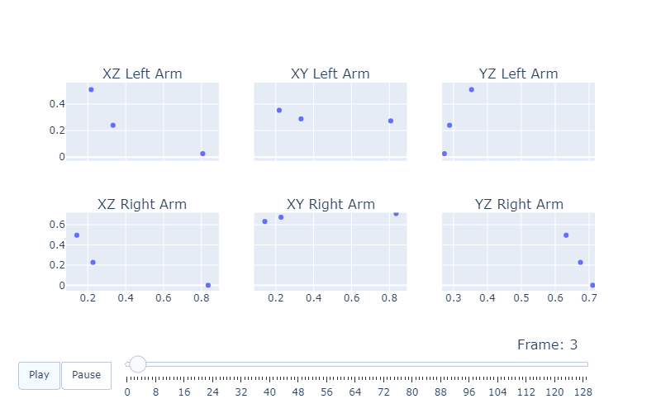
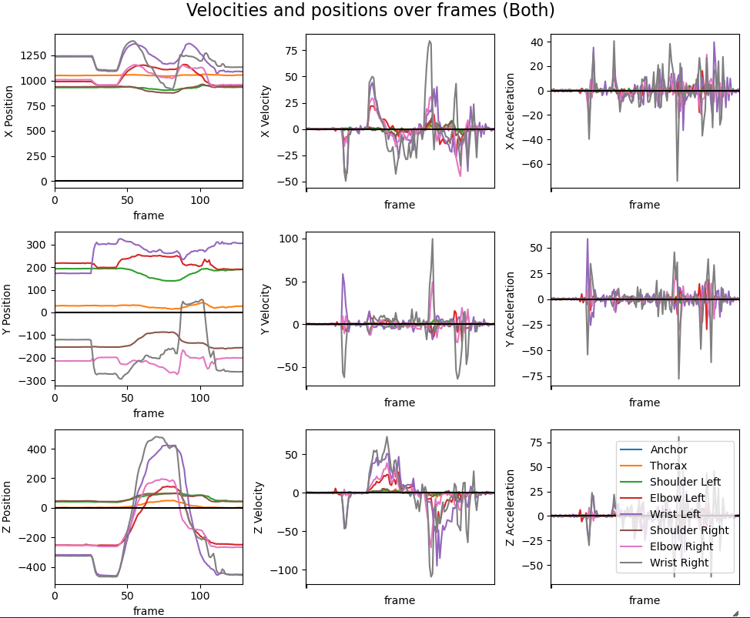
Throwback
- 2D plots of movements (no lines yet)
- Plotting the velocities
- Action items(Retrospective)

Slide 4
What did we do?
Rewrote our research question Which models can be added to the OR-ensemble to improve the classification of individuals to the correct patient group using the existing data from a Flock of Birds system?
Rewrote our Plan of Attack
Task division and focus Beau & Jasmijn: improving the previous week’s 2D plots Danny & Emma: normalization of the current dataset Donna & Tim: plotting the symmetry in height between the wrist and shoulder sensors
Another retrospective; another list of action items
Notes:
Analyze code from last year
Programming session
Create a simple classification model
Explore interesting features

Slide 5
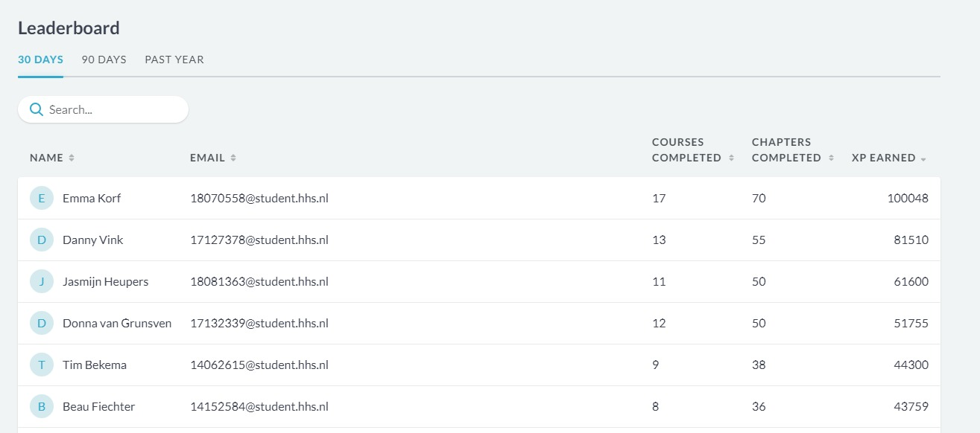

What did we do?
DataCamp progress
Notes:
Analyze code from last year
Programming session
Create a simple classification model
Explore interesting features

Slide 6
Results
Before
Beau & Jasmijn 2D plots; dots connected by lines
Notes:
Experimented with plotting the velocity and acceleration
Front- upper- and sideviews, to explore symmetry

Slide 7
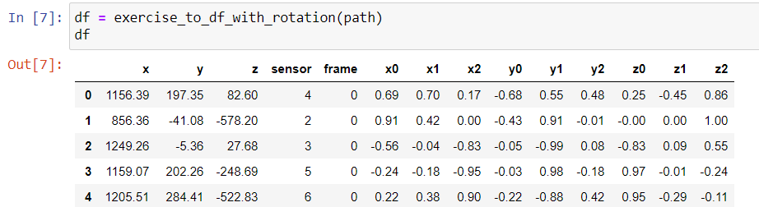
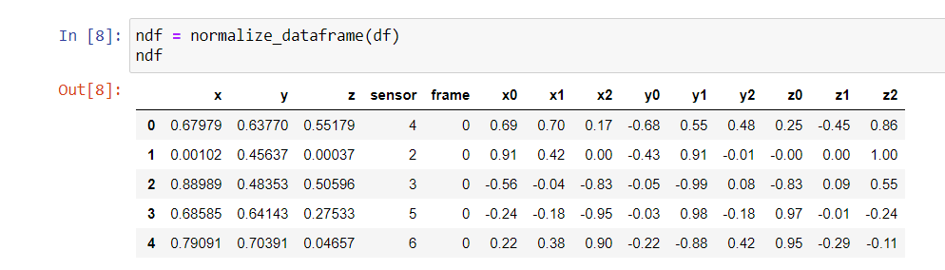
Results
Danny & Emma Normalization of the dataset
Before
After
Notes:
Experimented with plotting the velocity and acceleration
Front- upper- and sideviews, to explore symmetry

Slide 8
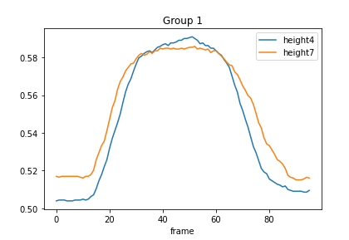
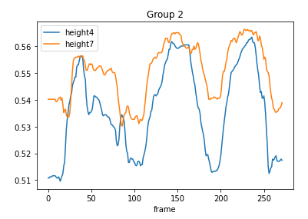
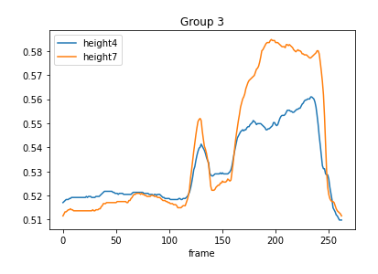
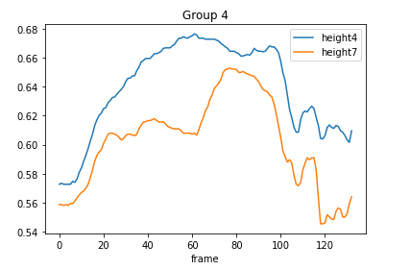
Results
Donna & Tim Heights of sensor points (shoulder and wrists) to look at symmetry
Wrists sensors category 1-4 Exercise: AB1
Notes:
Experimented with plotting the velocity and acceleration
Front- upper- and sideviews, to explore symmetry

Slide 9
What will we do next?
Task division and focus Beau & Jasmijn: correlation between right and left arms of patients Danny & Emma: plot the difference of symmetry of the rotation of the shoulder blade of patients Donna & Tim: look at possible data cleaning or other relevant features
Juptyer Notebooks pair programming improvements
Notes:
Analyze code from last year
Programming session
Create a simple classification model
Explore interesting features

Slide 10
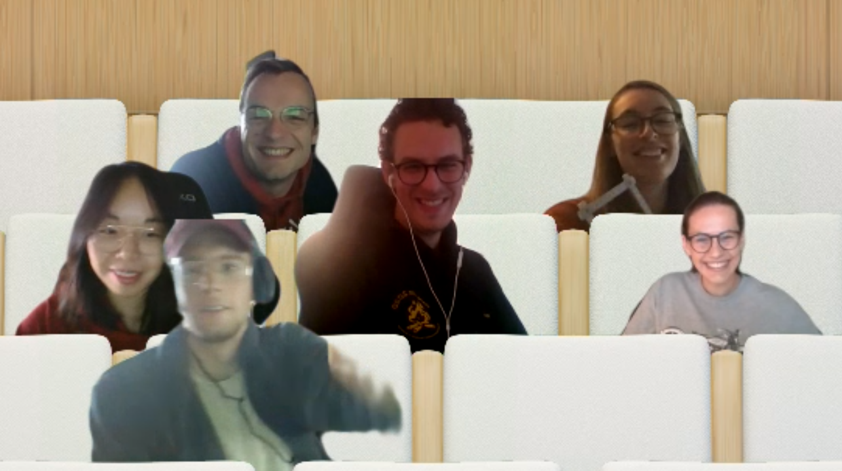
Questions?

